Slide 1
AIT 664
Project Presentation
Recommendation System
Submitted By:
(Team of Kubernetes)
Tejasri Surapaneni
Vamshidhar Reddy Gunnala
Sujan Chava

Slide 2
Objectives:
Determining which animation is liked by most of the users.
Which genre is liked by the users.
Recommending the animations based on same genre and type
Using clustering techniques for unsupervised learning of data.
Major Objectives of this Recommendation system Project

Slide 3
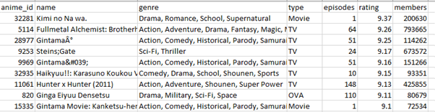
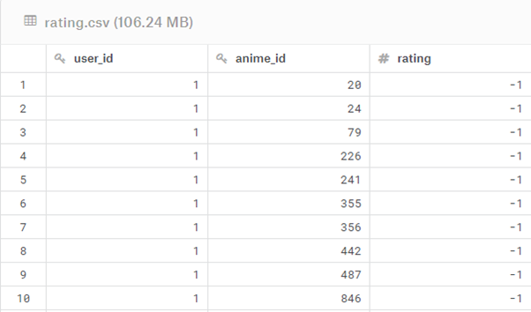
Proposed Selected dataset:
The dataset that selected contains information on use preference data from 73,516 users on 12,294 animations.
The dataset consists of features like user id, anime id, name, genre, type, episodes, rating and members.
User id and anime id are the primary keys which are used to identify the features uniquely and merge different dataset based on these attributes.
https://archive.ics.uci.edu/ml/datasets.php?format=&task=&att=&area=&numAtt=&numIns=&type=seq&sort=nameUp&view=table
https://www.kaggle.com/CooperUnion/anime-recommendations-database

Slide 4
Pre-Processing:
Imputing the Null / Missing values with various centralized measures.
Deleting the inappropriate Symbols or mis-matched datatype words from the dataset.
Deleting the null values which doesn’t play a vital role in the analysis or the columns which are significant but having null values.
Various Imputing methods like replacing the null values with the group by category and replacing them with the values based on the correlation between the values like type and episodes.

Slide 5
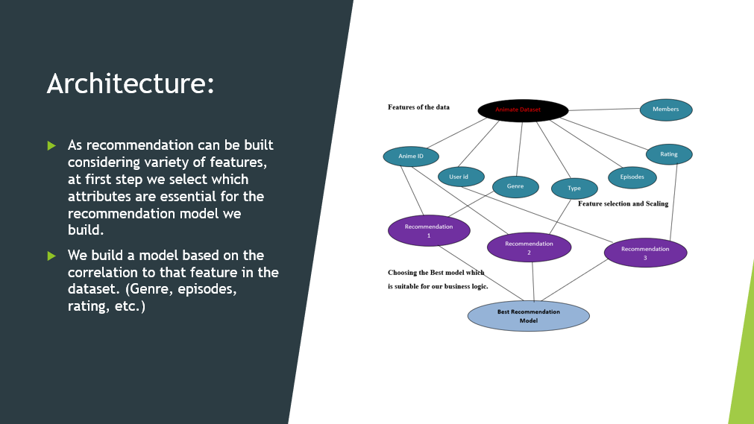

Slide 6
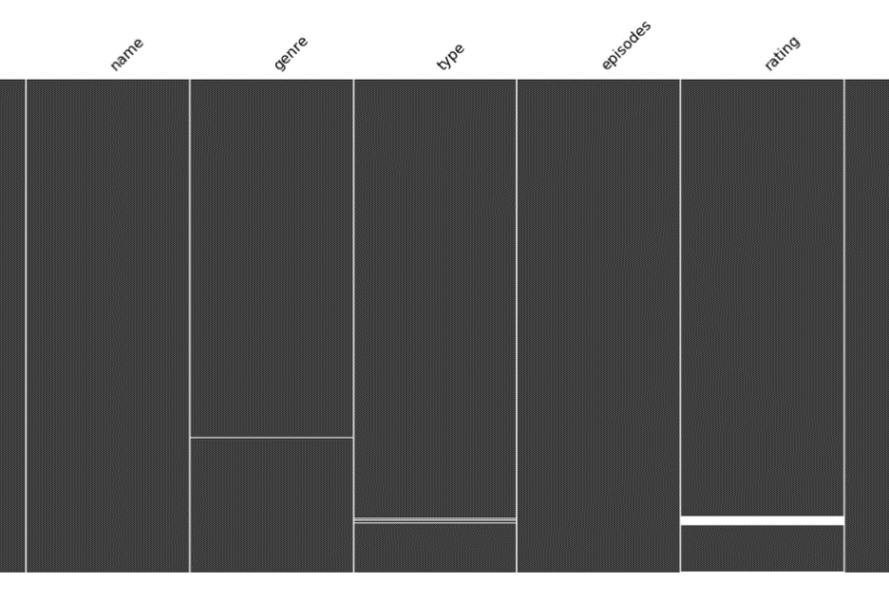
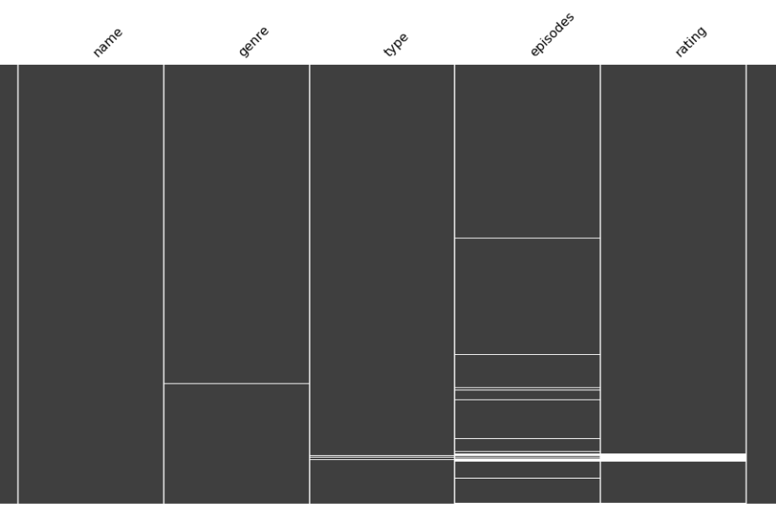
Identifying Null / Missing Values:

Slide 7
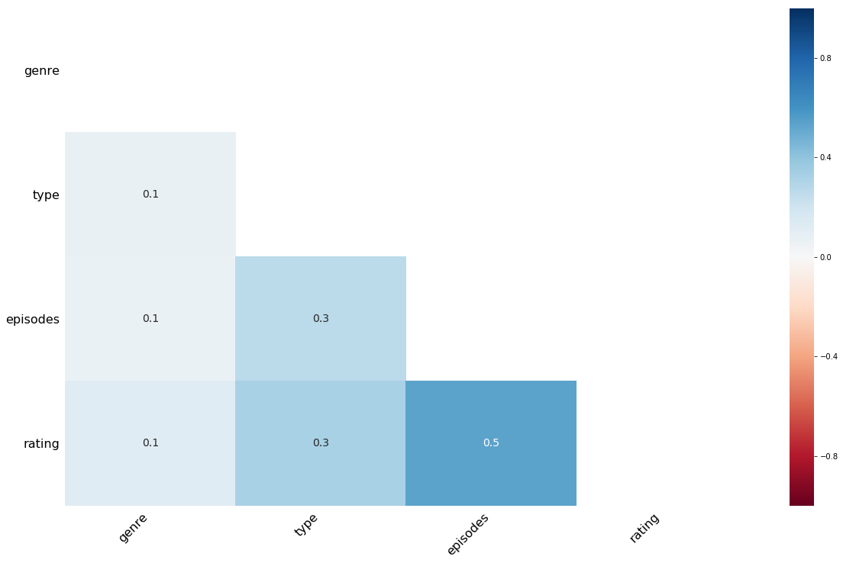
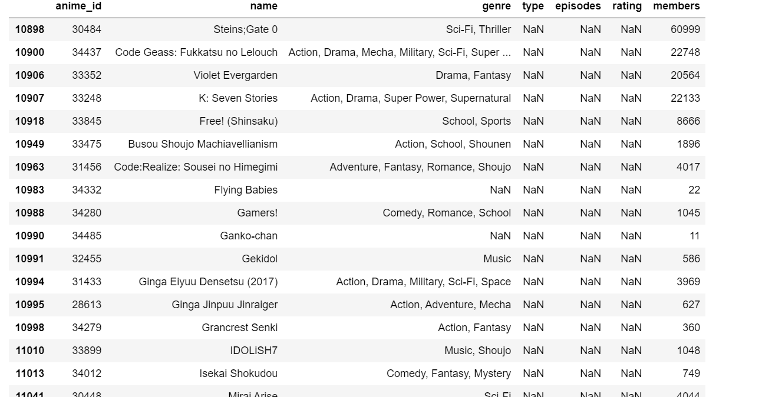
Handling null Values:
Identify the null / missing values if they are replaced with different words or symbols.
Know which column has highest null values and how important that column is for the analysis.
Remove the rows having excessive null values as they can introduce new bias.

Slide 8
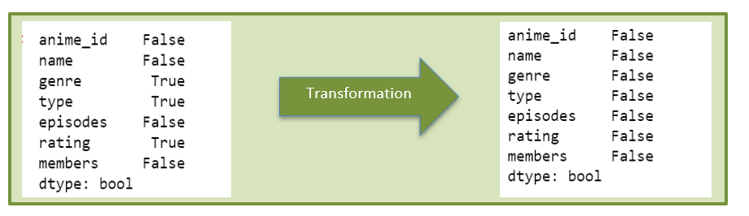
Transform the Data

Slide 9
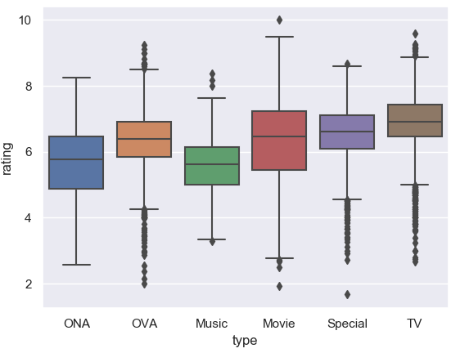
Visualizations
Box plot representation of different types of animations on X axis and rating on Y axis.

Slide 10
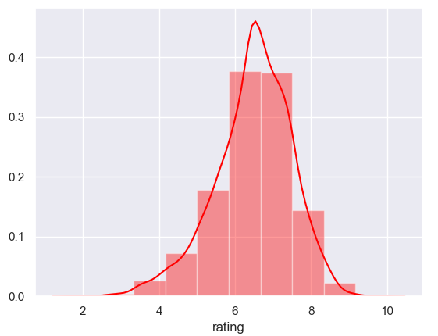
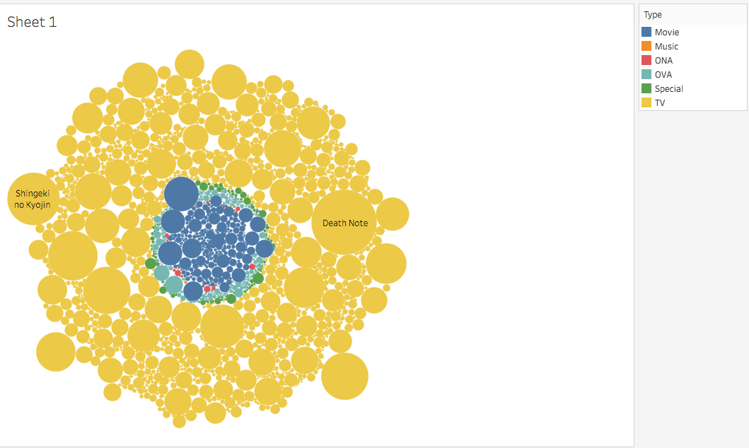
Graph Showing the predictor rating how normally distributed rather having heavy skewness or kurtosis.
Plot showing most liked type of show

Slide 11
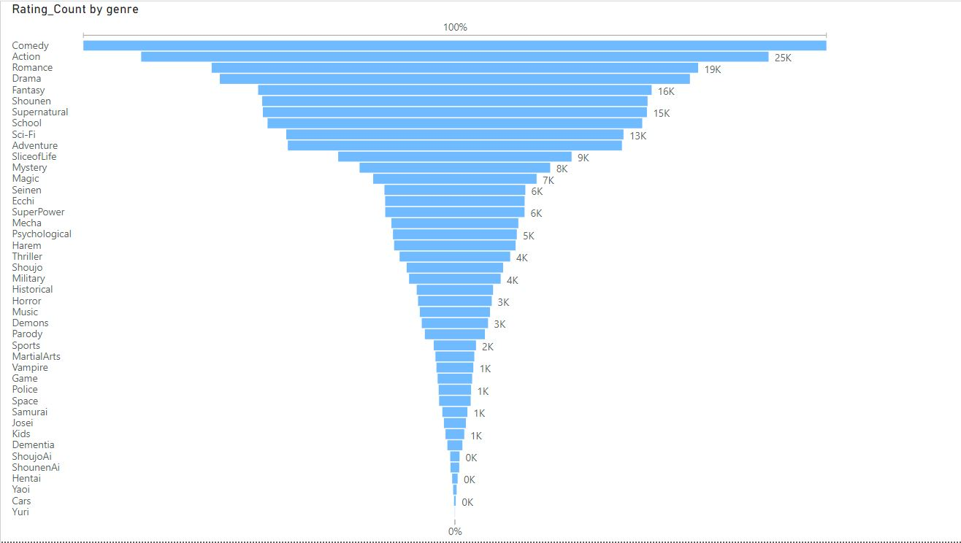
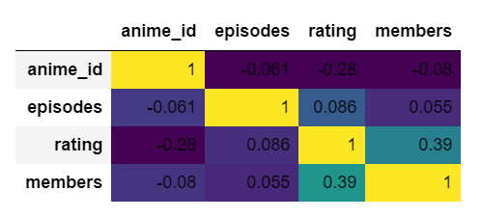
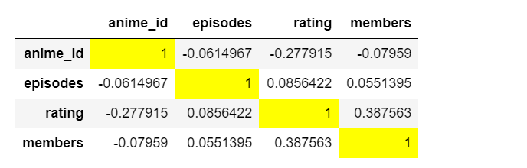
Showing correlation matrix for the variables
in the dataset
Displaying the categories in genre which identifies the mostly populated genre

Slide 12
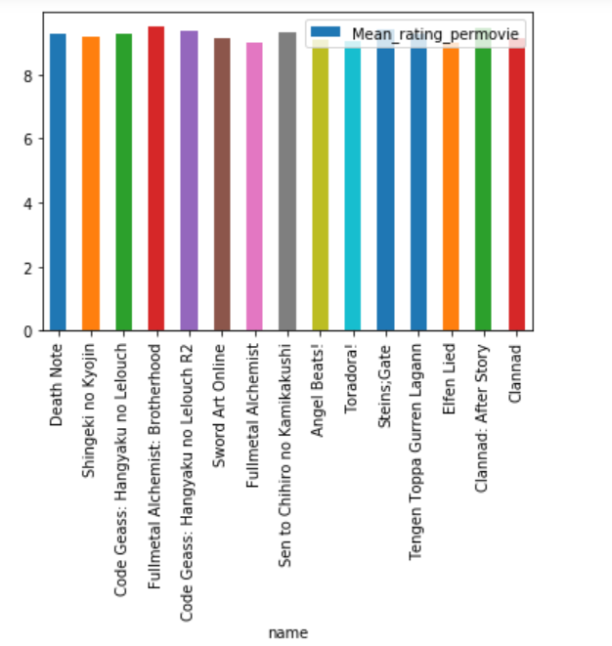
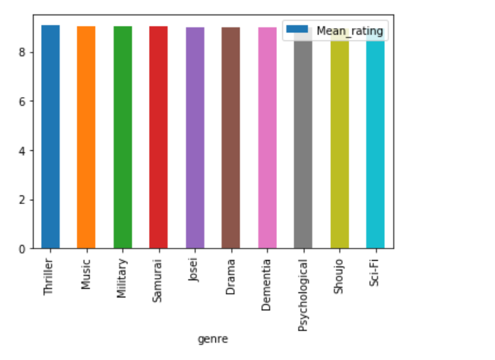
Mostly liked Animation and Genre based on rating and viewers

Slide 13
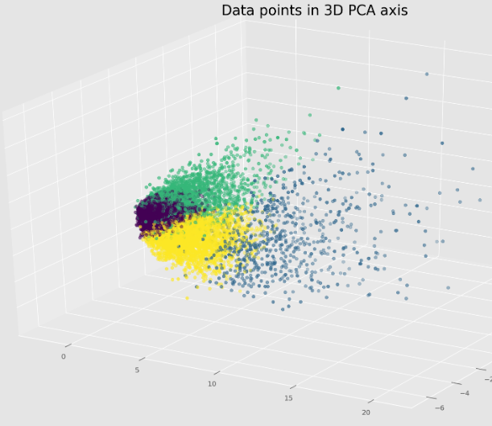
PCA Analysis
Identifying which features are important and significant for the analysis.
Feature selection and dimensionality reduction process which best helps to identify the features which plays a significant role given the set of all predictor variables of the dataset.

Slide 14
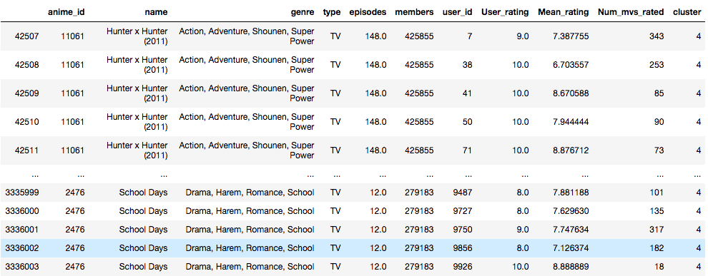
Final Dataset

Slide 15
K – Means Clustering

Slide 16
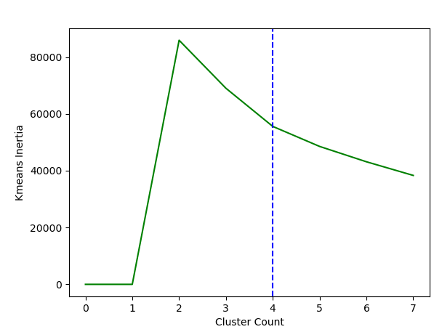
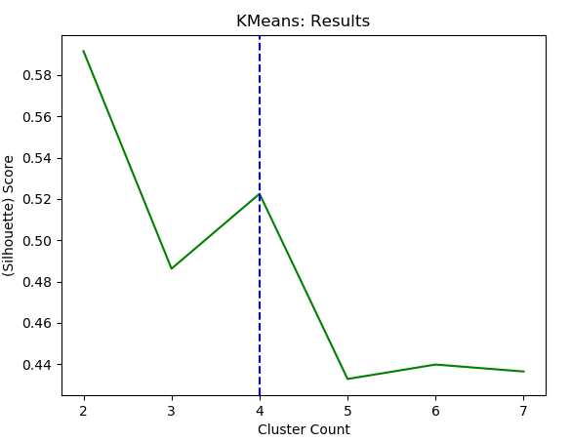
Displaying the cluster count vs. Silhoutte score to select the best value of K.
Silhouette score tells how far away the datapoints in one cluster are, from the datapoints in another cluster.
The range of silhouette score is from -1 to 1.
Displaying the cluster count vs. inertia to select the best value of K.
Inertia tells how far away the points within a cluster are. Therefore, a small of inertia is aimed for.

Slide 17
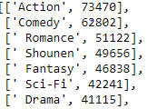
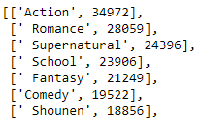
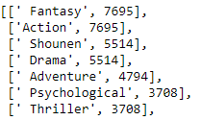
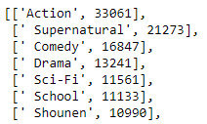
Displaying the results of the recommendation model where it generates the top 6 genres of the animations for each of the cluster.
Cluster 1
Cluster 2
Cluster 3
K-Means
Cluster 4

Slide 18


Cluster 1
Displaying the results of the recommendation model where it generates word cloud on each cluster to represent the most dominating genres of the animes for each of the cluster.
Cluster 2

Slide 19


Cluster 3
Displaying the results of the recommendation model where it generates word cloud on each cluster to represent the most dominating genres of the animation for each of the cluster.
Cluster 4

Slide 20
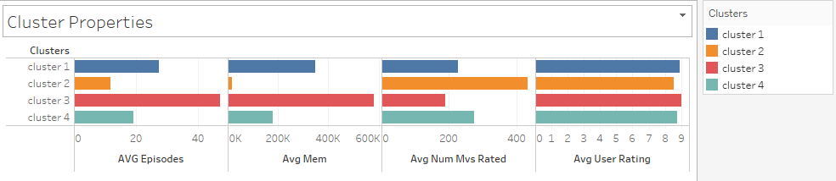
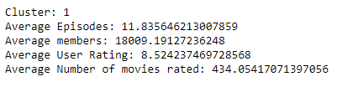

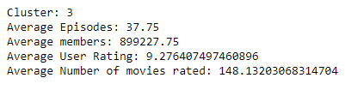
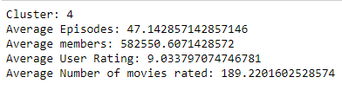
Cluster Properties
Cluster 1
Cluster 2
Cluster 3
Cluster 4

Slide 21
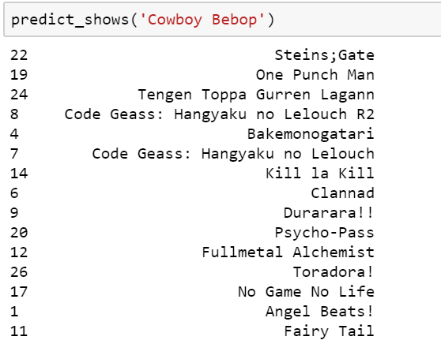
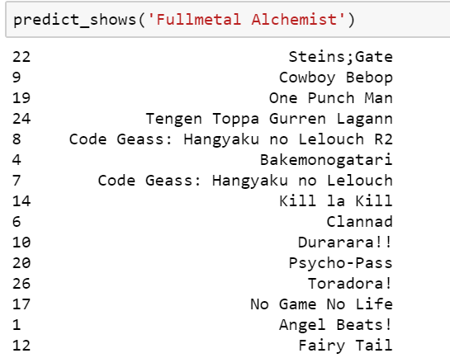
Predicting animations from the clusters

Slide 22
K – Nearest Neighbors

Slide 23
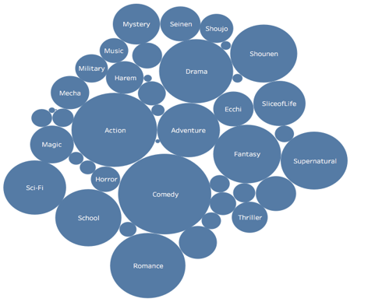
Genre Based on user rating

Slide 24


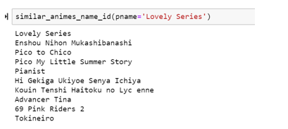
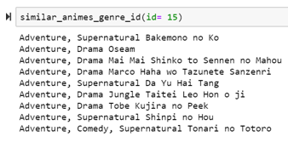
Displaying the results of the recommendation model where it generates the top 10 nearest neighbors (animations) based on the name of the animation.
Displaying the results of the recommendation model where it generates the top 9 nearest neighbors based on the id of the animation given the id of any animation.
Results

Slide 25
Semantic analysis - limitation
We have done partial semantic analysis for our data where we tried to recommend the shows based on the similarity in the semantics of the names and based on same type, genre.
This method of semantic analysis is very much useful for extracting and representing the contextual meaning of words by statistical computations applied to a large corpus of text.
The limitation is that we need to have data that is being related or having some pattern to identify the relationship which in our scenario it is limited to few of the shows that vary with the other features like genre, type but yet provided some other information like description and the people who casted it etc. can help to develop a model by conducting different analysis.
Semantic analysis is more helpful to recommend the shows based on the names and it is more useful to recommend the shows by mapping with the partition as partial names and similarity within the names.

Slide 26
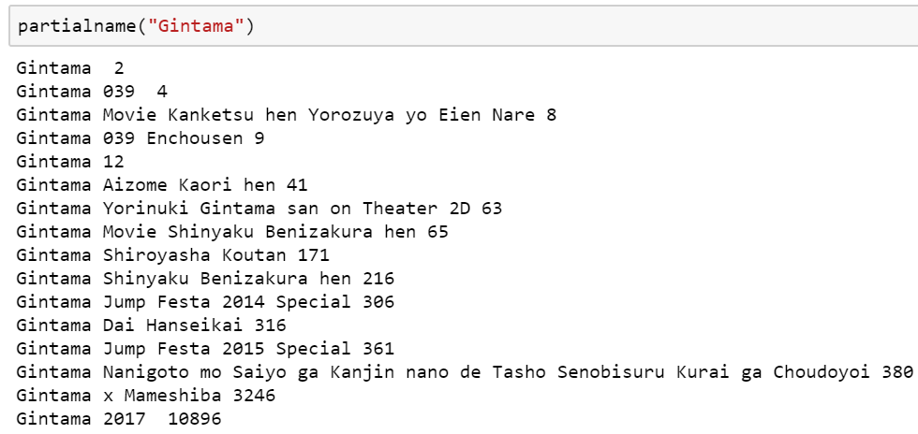
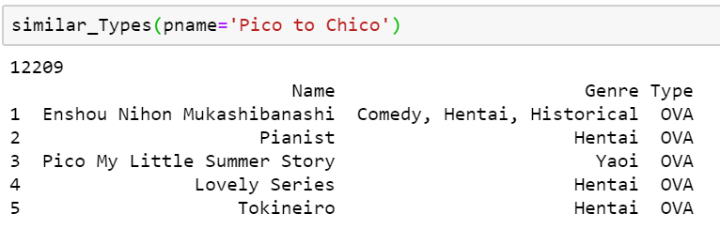
Recommending the shows based on the similarity in the names and based on same type.

Slide 27
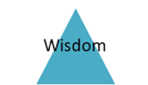

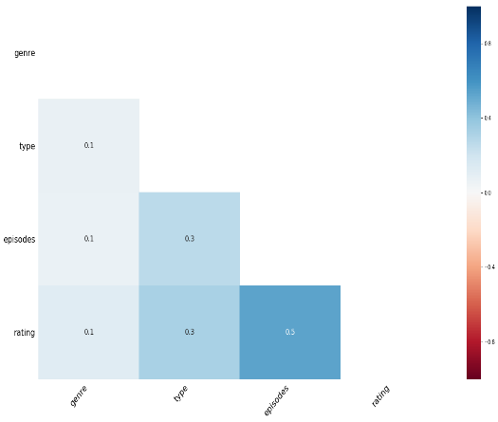






Slide 28
Challenges and lessons Learned
Applying different techniques to handle NULL values of each column based upon the correlation of the attributes.
How to define like (considering the users who viewed each anime and who rated them) based on user rating ,anime rating and on a condition that user rating for an anime is more than the mean rating.
Finding the best value of ‘K’ in K-means clustering based on inertia and silhouette score.
Calculating the distance between the categorical variables using Binary Euclidean Distance, coefficient of similarity and Hamming distance.
Using clustering technique for recommending the shows.
Using supervised modelling technique to an unsupervised data (KNN).
Using semantic analysis technique for recommending various shows.

Slide 29


Slide 30


